Slide 1


Corporate Care Clinic
Presented by:
Missy Tate, MBA, MSN, APNP, COHPM
Notes:
Hi I am Missy Tate, the Director of Agnesian Work & Wellness, and I am here to talk to you about the benefits of your Corporate Care Clinic. The Corporate Care Clinic is a clinic dedicated to FABOH members only. It's a clinic just for you with providers dedicated to work with you on your personal health and wellness.

Slide 2
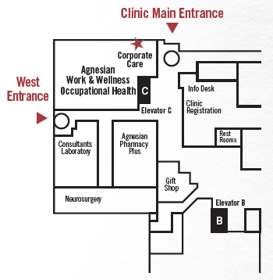
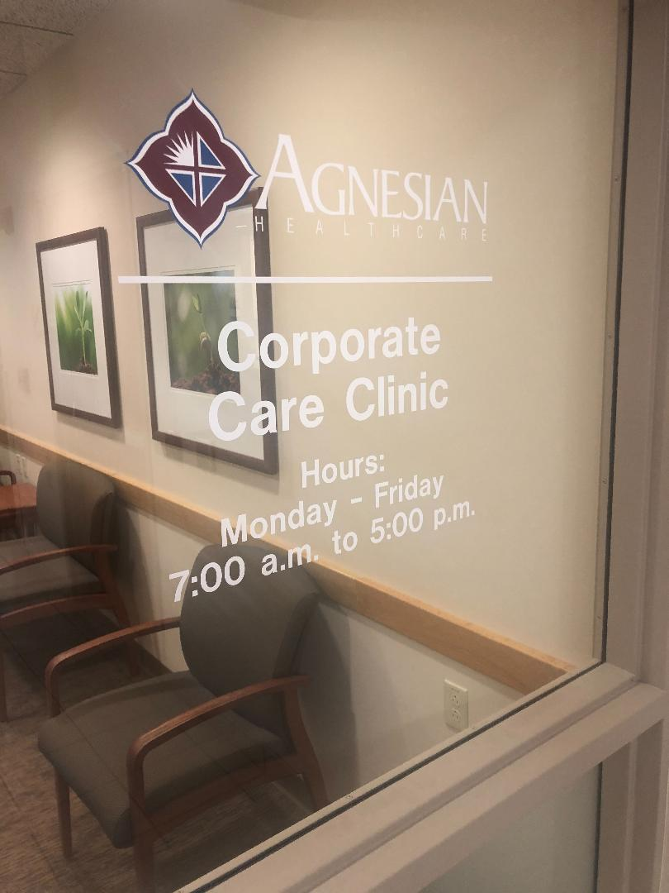
Location
420 E. Division Street
Fond du Lac, WI
920-926-5578
Enter thru Fond du Lac Regional Clinic entrance
Corporate Care Clinic is right inside the entrance
Notes:
We are located in the Fond du Lac Regional Clinic at 420 E. Division Street in Fond du Lac. The Corporate Care Clinic entrance is right as you enter the Clinic Main Entrance.

Slide 3
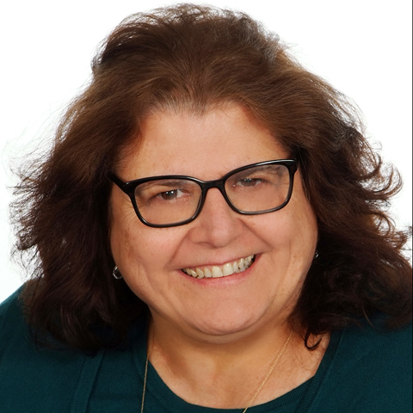
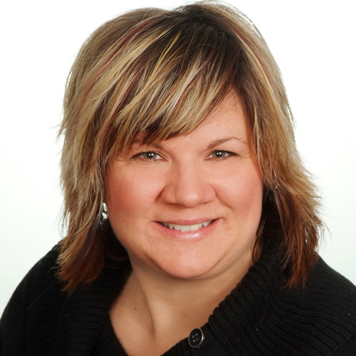
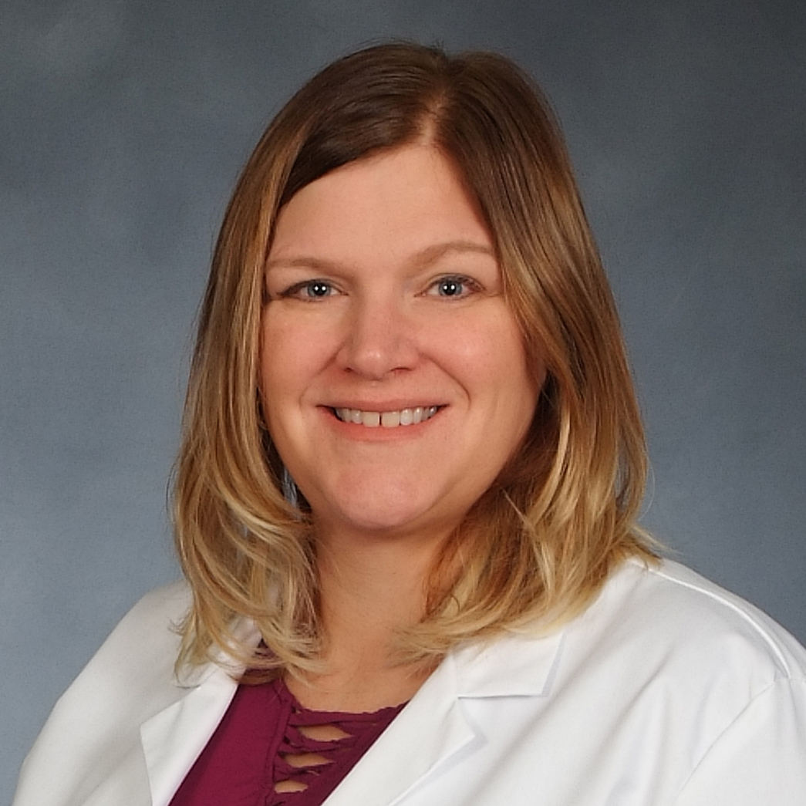
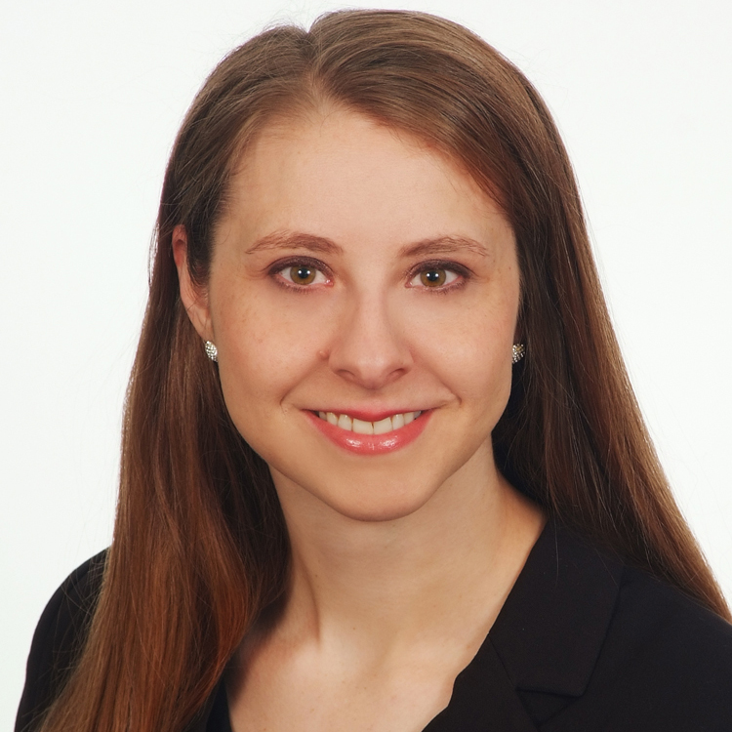
Providers
Louann Biddick, APNP
Jammi Cairns, APNP
Lisa Liedke, APNP
Janet Drummond, PA-C
Notes:
Our highly-qualified team of family medicine providers and support staff love to work with their patients. They are proud to show that service is key with an average patient satisfaction rate of over 90%.

Slide 4


Wellness Visits
Notes:
Corporate Care Clinic providers will assist you with being your healthiest self; offering wellness visits for those over the age of 11. These wellness visits includes annual wellness exams, well-child exams, and school or sports physicals.

Slide 5

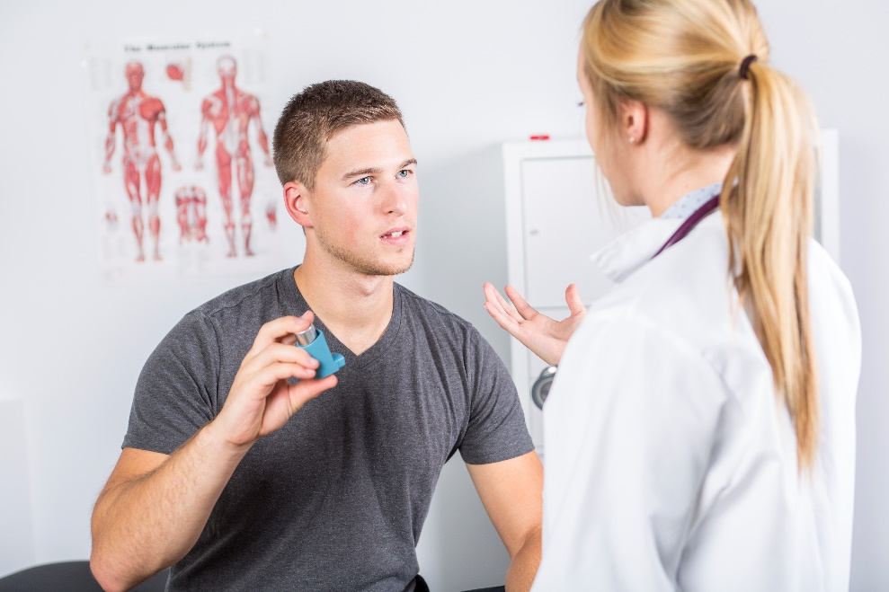
Chronic Care and Acute Care
Notes:
Our providers are experienced and qualified to assist in management and education of chronic diseases such as diabetes, high cholesterol, high blood pressure, heart disease, asthma, and thyroid disorders.
We have a provider dedicated to walk-in visits each day to ensure same day visits are available for acute care needs. Those over the age of 5 years of age can be seen for things such as urinary tract infections, sinus infections, colds or respiratory symptoms, ear aches, sprains or strains.

Slide 6
Billing
The care and scope of practice provided by the Work & Wellness Providers falls into these 9 CPT codes:
  99202 office/outpatient visit, new
  99203 office/outpatient visit, new
  99211 office/outpatient visit, established
  99212 office/outpatient visit, established
  99213 office/outpatient visit, established
  99214 office/outpatient visit, established
  99394 Preventative visit, established, age 12-17
  99395 Preventative visit, established, age 18-39
  99396 Preventative visit, established, age 40-64
Notes:
Each of the nine CPT codes has a unique, discounted price paid by the FABOH member. How cost is shared between the employer and the covered lives on the employer’s health plan is determined by the employer's plan design.
For those services provided by the provider at the Corporate Care Clinic, but not listed in the codes above, reimbursement will be at the lowest rate associated with FABOH’s fee schedule with Agnesian Healthcare less 15%.

Slide 7
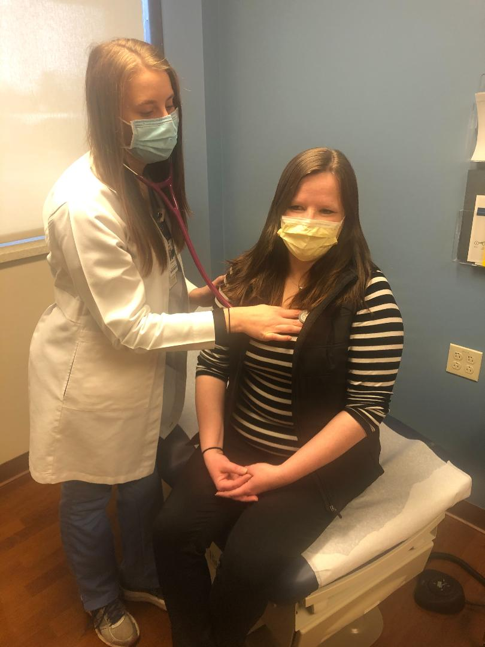
Partnership with Provider
Notes:
When you establish with our providers, together we will work to build a relationship with you to be a partner in your care. This includes the ability to manage your prescriptions. We know the importance of listening to your health care needs and together will discuss your wellness goals.
Our access to care is exceptional! Wellness services are typically available within 1 week and acute services the same day.

Slide 8

SSM Health MyChart
Get the SSM Health MyChart APP - quick and most convenient way to stay connected with your healthcare team!
Request and cancel appointments
Request medication refills
Review your lab results
Send messages directly to your provider and receive timely responses
See your provider through video appointments
Notes:
With our transition to Epic electronic medical record in March of 2020, our patients now have access to their medical record through SSM Health MyChart. MyChart has many benefits including requesting and cancelling appointment, requesting medication refills, reviewing your lab results and notes from visits from your providers, messaging with your providers, and even completing a video visit. All of this is to enhance your relationship with your provider.

Slide 9
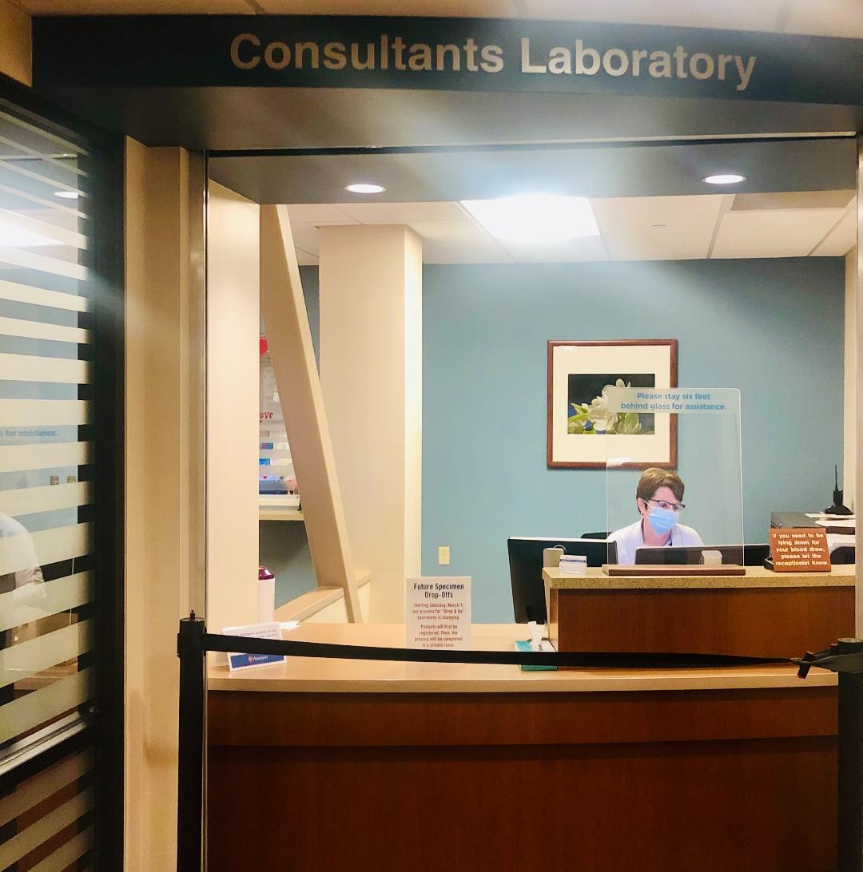
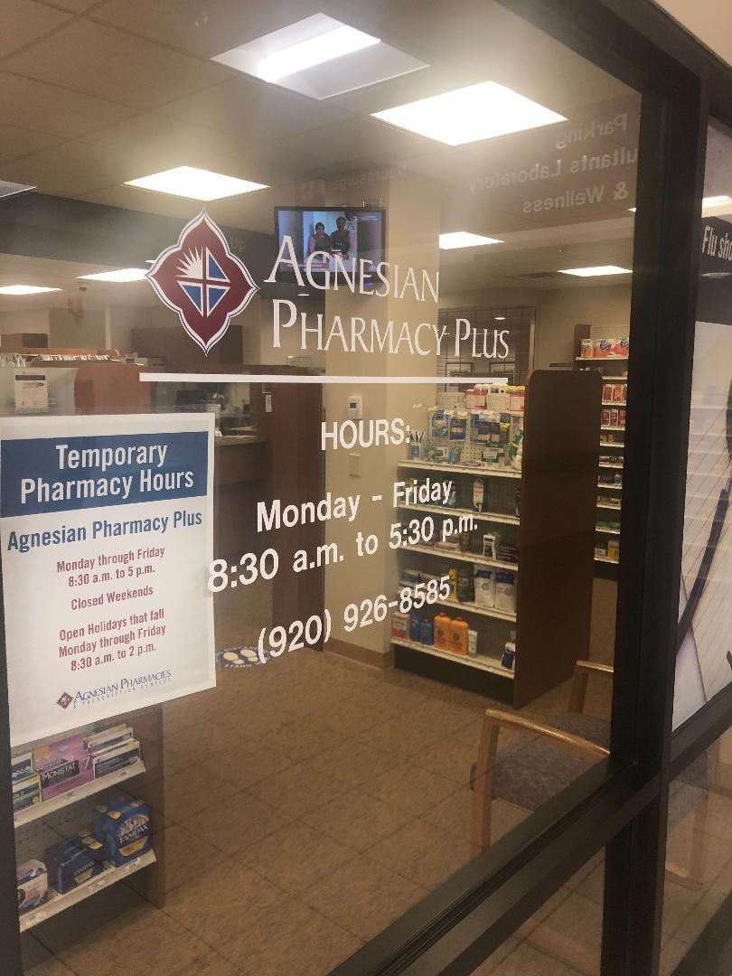
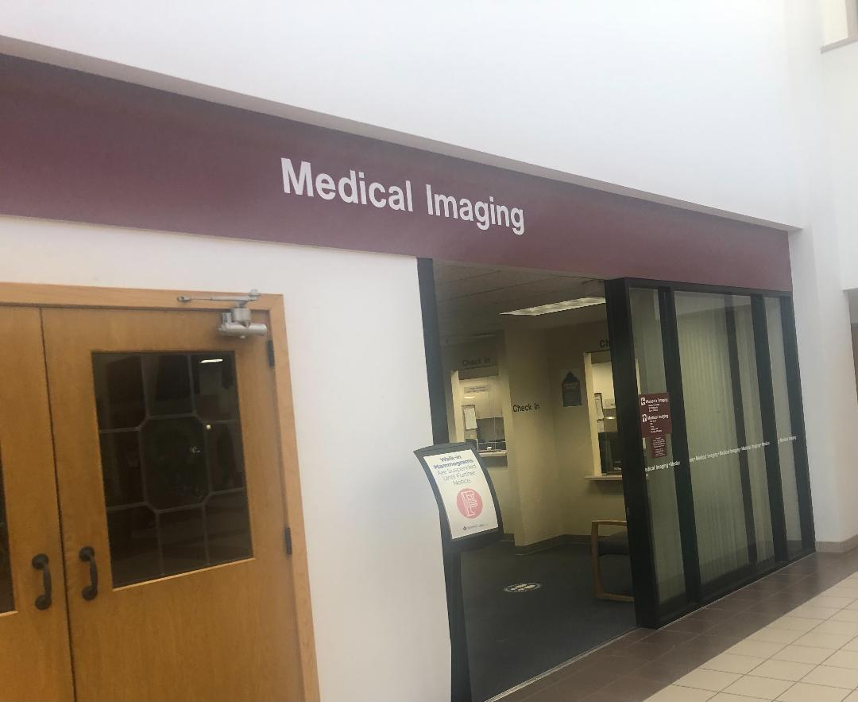
Easy Access to Services
Notes:
Your Corporate Care Clinic is conveniently located in a facility that offers you easy access to additional services such as Outpatient Pharmacy, Laboratory Services, and Imaging Services.

Slide 10
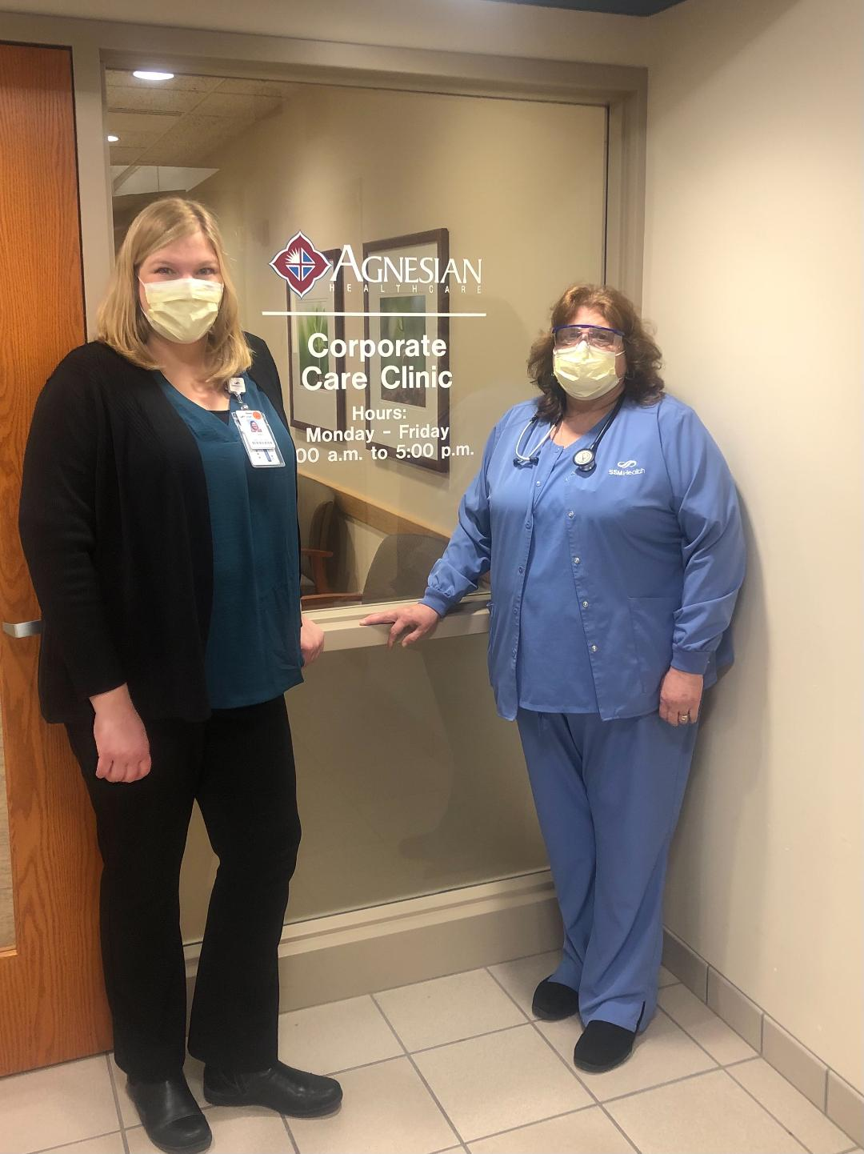
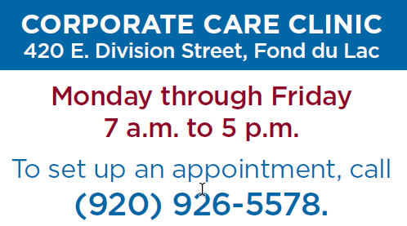
Lets partner together!
Notes:
We are here for you and happy to help. Reach out to us today to schedule your appointment at 920-926-5578.

